Slide 1
Arlington County Open Data Portal
Mark Almanza, Madison Arnsbarger,
Jessica Flynn, Millicent Grant, Adrienne Rogers, William Sandholtz,
Emily Stark, Samantha Tyner

Slide 2
Introduction
Madison Arnsbarger

Slide 3
Introduction
“Open data is the idea that public information should be accessible to the public online.”
“...improved measurement of policies, better government efficiency, deeper analytical insights, greater citizen participation, and a boost to local companies by way of products and services that use government data”
Shueh, Jason. "Open Data: What Is It and Why Should You Care?" Government Technology Magazine. N.p., 17 Mar. 2014. Web. 15 June 2016.

Slide 4
Criteria
User Interface
Organization
Navigation
Design
Data
Tidiness
Accessibility
Documentation
Visualization

Slide 5
User Interface

Slide 6
Organization
Millicent Grant

Slide 7
Organization
Importance of Context
Include descriptive information
Give explicit cues
Provide additional resources to aid users in their exploration
Notes:
CHANGE FONT SIZE MILLI!!!!!!!!!!!!

Slide 8
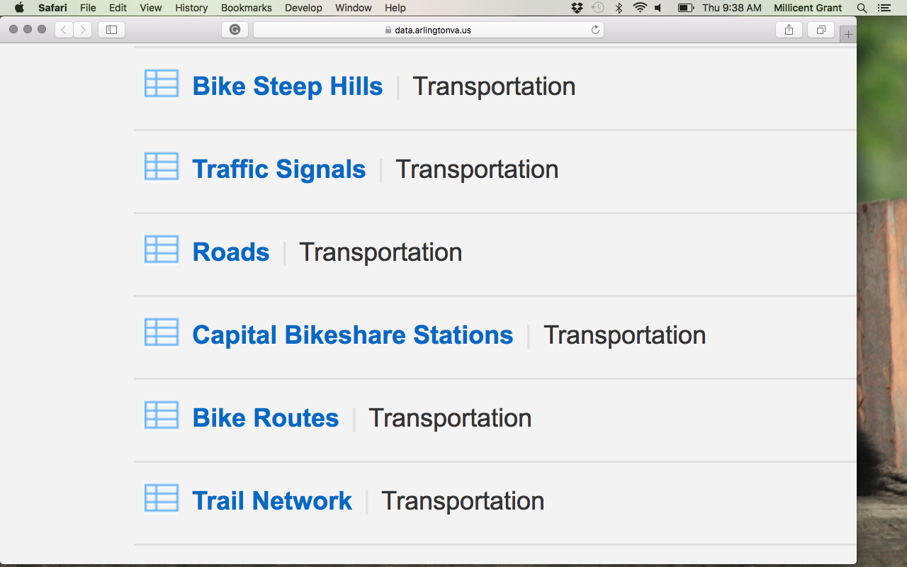
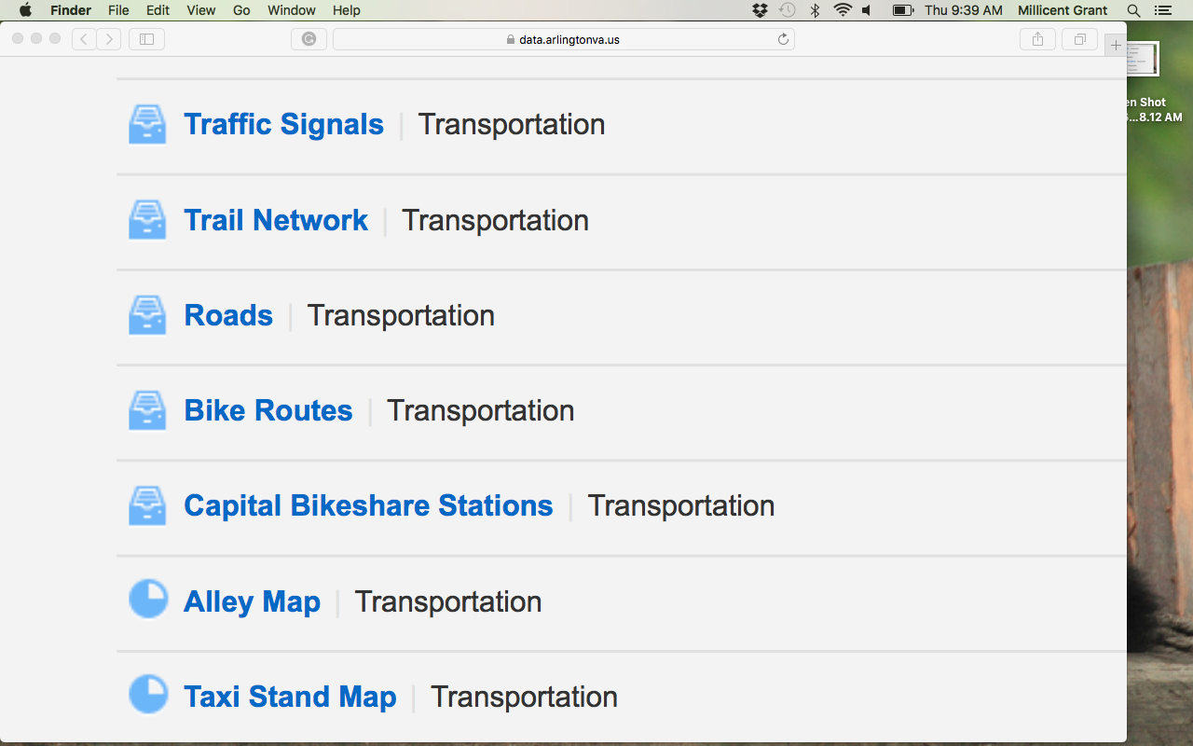
Each web page and each table should be organized consistently
https://data.arlingtonva.us/home
Notes:
Nest folders and links by topics
Site hierarchy need to be clear and minimize the user’s steps to navigate to a particular page
THROW THEM A BONE: say something about how they might have been making a place holder to put something else in the folder

Slide 9
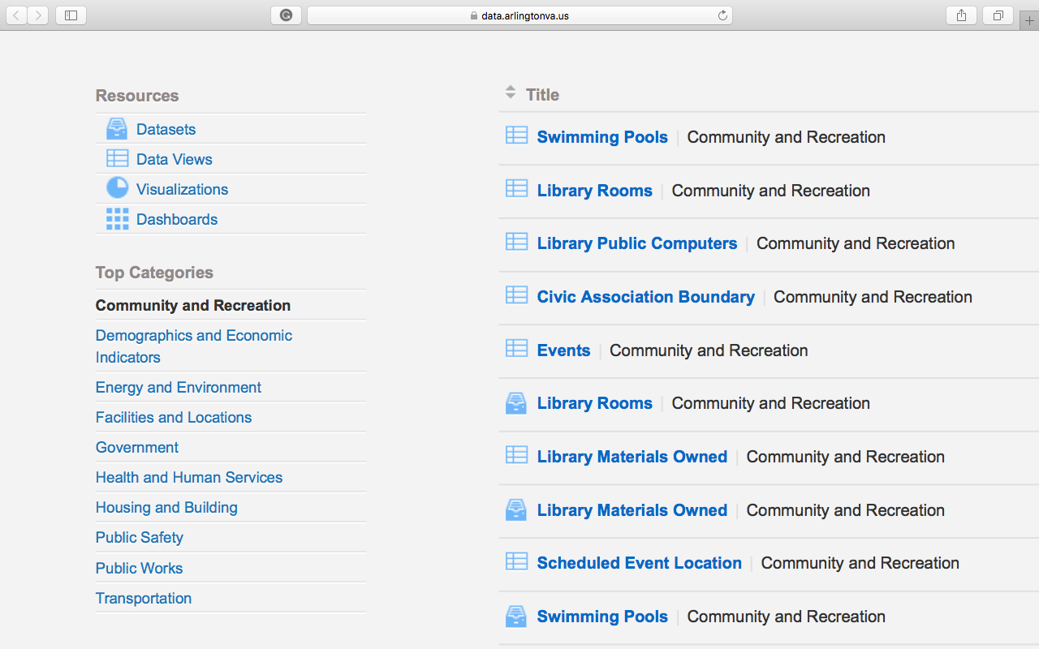
Lists of any kind should be sorted in the same manner
Standard: Alphabetically
Optional: provide users with alternative sorting methods
https://data.arlingtonva.us/home
Notes:
BLOW UP THE LIST include link even if is from Arlington

Slide 10
Navigation
Emily Stark

Slide 11
Navigation
Users should always know where they are
If they become lost, they should know how to get out

Slide 12
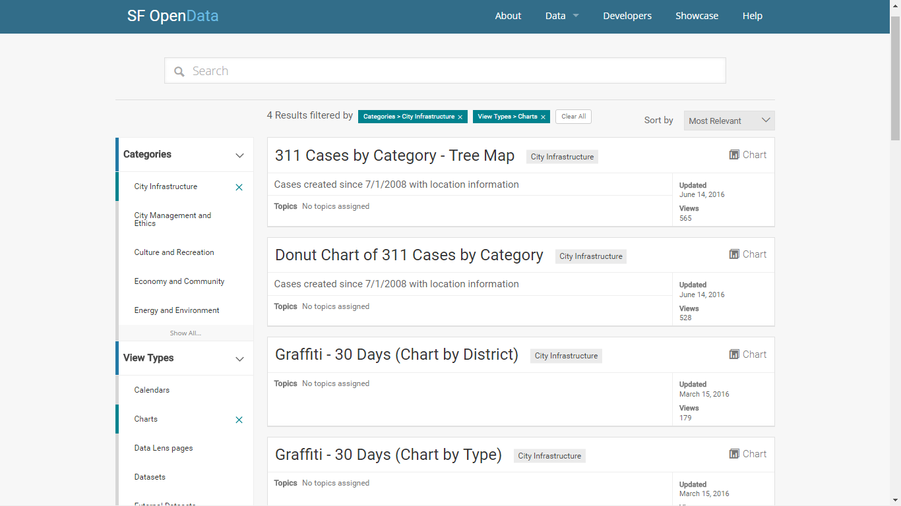
Example
https://data.sfgov.org/browse?category=City+Infrastructure&limitTo=charts&utf8=

Slide 13
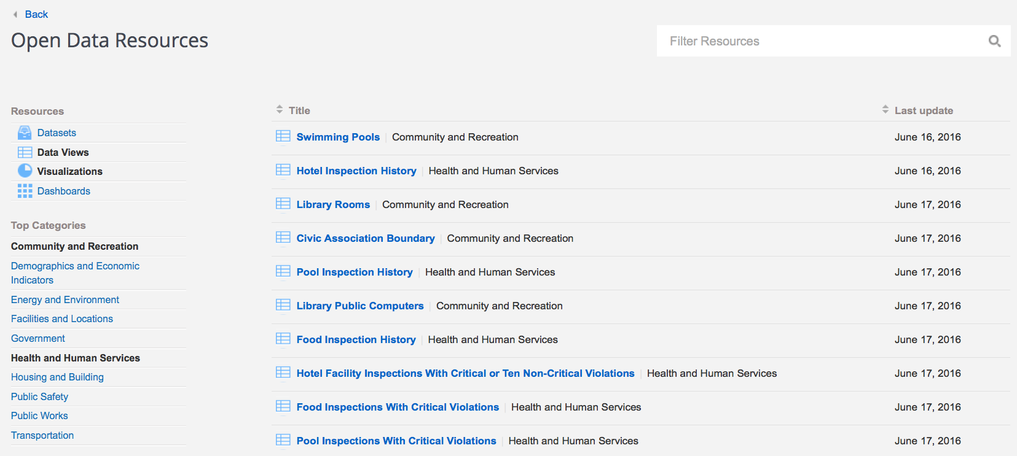
Arlington County
https://data.arlingtonva.us/home/

Slide 14
Design
Mark Almanza

Slide 15
Design
The design of the site should add to the user’s experience
An open data portal should:
be easy to read
have a consistent style
highlight things important to the user
inform the user about the data at a glance
imply the use of tools presented to the user
Notes:
The design of the site should add to the user’s experience
Ideally, a regular user shouldn’t even notice the design of a website anymore
The internet is mature enough that there is a certain expectation of design from sites that expect wide use
And, while an open data portal doesn’t need to worry about some elements of design as much as others, there are some important elements
An open data portal exists to disseminate information, so its design should reflect its purpose
It needs to be easy to read for potentially extended periods of time
Its style should remain clean, simple, and above all, consistent.
Its design should
highlight all the items the designer feels are important to the use of the odp
give the user an idea of the exact kind of data they are going to see, before they click on it
help the user make the best use of the statistical tools given to them

Slide 16
Design
Easy to read
Text should have high contrast to the background
Like this
or this
Otherwise it can be hard to read : like this
Text should be clear
Neat, legible fonts should be used
Messy, dense fonts should be avoided
Notes:
Your ODP should be easy to read
Your text should be very different in color from the background to ensure that everyone can can read from your page easily
good pairs are
black and white
black and light grey
vibrant complementary pairs like
red and orange
yellow and orange
blue and yellow
Your text should be in a neat and legible font, preferably sans-serif
These two fonts are in the same size, but the top is clearly more readable

Slide 17
Design
The design should be consistent throughout the site
The color scheme and placement of tools should be kept the same
Unless the change is meant to highlight a new tool
Notes:
A consistent design system can help the user to navigate the site by letting them simply get used to how things are laid out
Less is more when it comes to colors in an informational site like an ODP, too many flashy colors in the site’s regular design can be distracting, as well as limiting the choice of colors to use as highlights
The times when one does want to change up the layout are when new tools have been added to the site, but even then, one should change as little as possible
Just don’t change up things like the background, for instance, if the addition is just a popup window or a toolbar

Slide 18
Design
Important functions should be highlighted
A user should see all of the important functions as soon as they land on the home page
Notes:
The site’s design should draw the user’s eye towards the tools they need to navigate the site
Ideally, the user should see everything they will need as soon as they open the page
see the following example

Slide 19
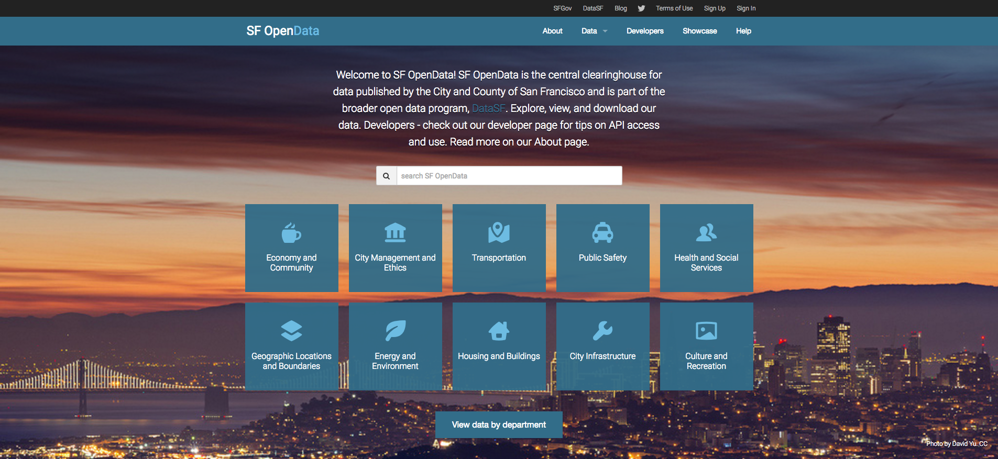
Example
https://data.sfgov.org/
Notes:
This is the San Francisco ODP’s main page, as you can see, all of the primary functions are visible immediately
The search bar, all of the genres of data one can browse by, and a link to another way to browse

Slide 20
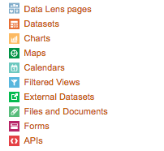
Design
The design should present information to the user before they click on a dataset or visualization
Different types of data should be differentiable at a glance
https://data.cityofchicago.org/
Notes:
The design of the site should allow a user to get some basic information about the data they’re looking at before they even click on it
A user should be able to, at a glance, determine if a link is what they want
This is an example from Chicago’s ODP, which has several kinds of data to choose from, each with its own color and picture, seen beside every link

Slide 21
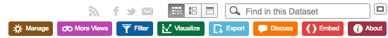
Design
The design should imply the function of the tools presented to the user
The use of graphics, colors, and labeling should create a set of easily differentiated tools
https://data.cityofchicago.org/
Notes:
In order to maximize use and utility of the site, it should not presume an in-depth knowledge of statistics, once a user has selected a data set to work with, the design should help the user to determine the use of the tools presented to the user
The sites design should use graphics, colors, and labeling to differentiate the tools it presents to the user
graphics are the most important tool of the designer to inform the user, because people are excellent at processing images
colors are best used with graphics to help a user either just differentiate similar graphics, or even help to remember the layout of the site across multiple visits
labels can be an important tool to help the user deal with the more esoteric tools presented to them, and if the designer can include them without overcrowding the page, then they should, but over-labeling can
actually cause the page to be more difficult to make sense of

Slide 22
Data

Slide 23
Data Tidiness
William Sandholtz

Slide 24
Tidiness
Basic criteria for “tidy data”:
Each variable forms a column
Each observation forms a row
Name | Sex | Date of Birth | Height (in) | Start Year | End Year
Amanda | F | 03/07/1968 | 66 | 1990 | 1996
Bradley | M | 11/05/1971 | 70 | 1994 | 1999
Connor | M | 07/17/1964 | 68 | 1988 | 1992
Danielle | F | 10/22/1970 | 67 | 1997 | 2005

Slide 25
Tidiness
Common problems with data:
Columns headers are values, not variable names
Multiple variables are stored in one column
Variables are stored in both rows and columns
More difficult to use data

Slide 26
Tidiness
Columns headers are values, not variable names
Name | Male | Female | Height (in) | Start Year | End Year
Amanda | False | True | 66 | 1990 | 1996
Bradley | True | False | 70 | 1994 | 1999
Connor | True | False | 68 | 1988 | 1992
Danielle | False | True | 67 | 1997 | 2005

Slide 27
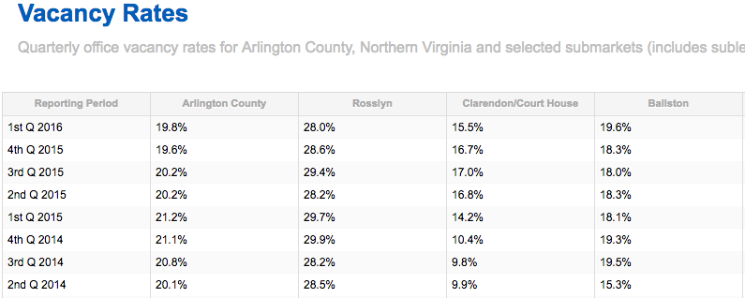
Tidiness
Column headers are values, not variable names
Link goes here

Slide 28
Tidiness
Multiple variables are stored in one column
Name | Sex | Date of Birth | Height (in) | Years Active
Amanda | F | 03/07/1968 | 66 | 1990-1996
Bradley | M | 11/05/1971 | 70 | 1994-1999
Connor | M | 07/17/1964 | 68 | 1988-1992
Danielle | F | 10/22/1970 | 67 | 1997-2005

Slide 29
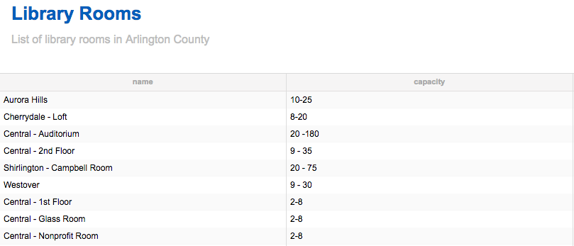
Tidiness
Multiple variables are stored in one column
Link goes here

Slide 30
Tidiness
Variables are stored in both rows and columns
 | Amanda | Bradley | Connor | Danielle
Sex | F | M | M | F
Date of Birth | 03/07/1968 | 11/05/1971 | 07/17/1964 | 10/22/1970
Height (in) | 66 | 70 | 68 | 67
Start Year | 1990 | 1994 | 1988 | 1997
End Year | 1996 | 1999 | 1992 | 2005

Slide 31
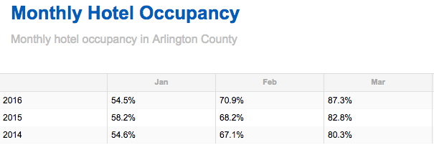
Tidiness
Variables are stored in both rows and columns
Link goes here

Slide 32
Tidiness
More tidy suggestions:
Keep units in column headers
Make sure that variables are internally consistent
Try to format special data types (dates, currency, etc) in a coherent, consistent manner across datasets
Makes data easy to use

Slide 33
Tidiness
Keep units in column headers
Name | Sex | Date of Birth | Height | Start Year | End Year
Amanda | F | 03/07/1968 | 66 inches | 1990 | 1996
Bradley | M | 11/05/1971 | 70 inches | 1994 | 1999
Connor | M | 07/17/1964 | 68 inches | 1988 | 1992
Danielle | F | 10/22/1970 | 67 inches | 1997 | 2005

Slide 34
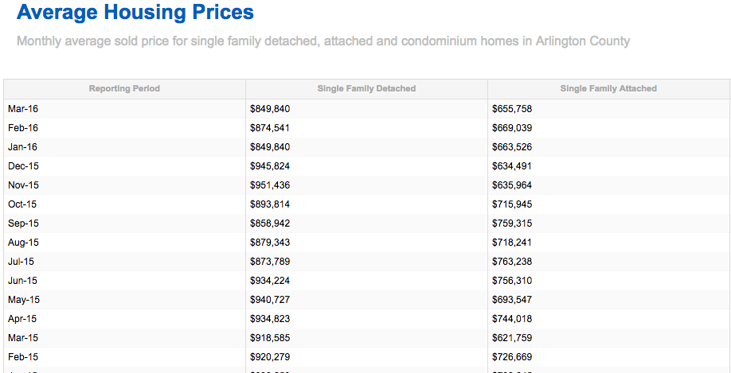
Tidiness
Keep units in column headers
Link goes here

Slide 35
Tidiness
Make sure that variables are internally consistent
Name | Sex | Date of Birth | Height (in) | Years Active
Amanda | Female | 03/07/1968 | 66 | 1990-1996
Bradley | M | 11/05/1971 | 70 | 1994-1999
Connor | male | 07/17/1964 | 68 | 1988-1992
Danielle | f | 10/22/1970 | 67 | 1997-2005

Slide 36
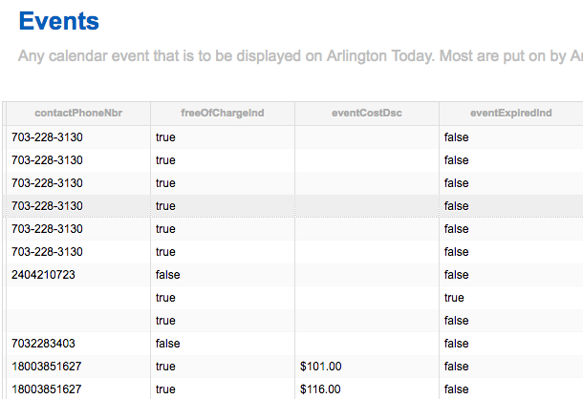
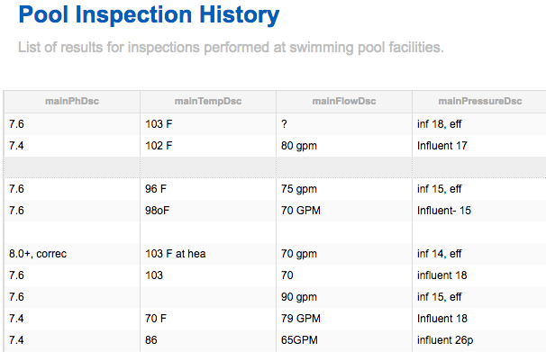
Tidiness
Make sure that variables are internally consistent
Link goes here
Link goes here

Slide 37
Tidiness
Try to format special data types (dates, currency, etc) in a coherent, consistent manner across datasets
Name | Birthday
Eric | 01/14/1980
Francis | 04/20/1979
Gail | 12/02/1975
Hannah | 08/10/1973
Winner | Date
Isabelle | October 21, 2015
Jakob | May 4, 2000

Slide 38
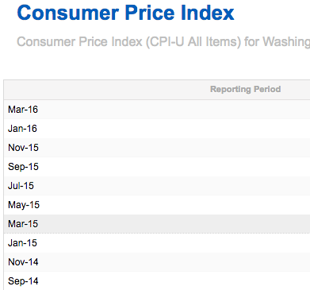
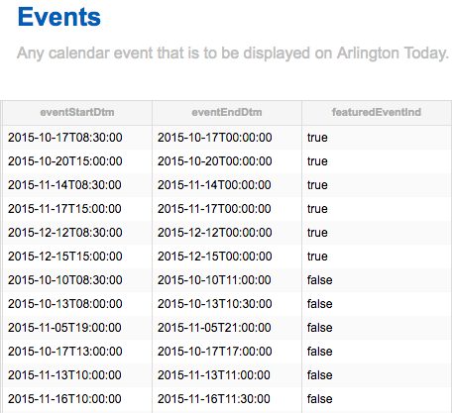
Tidiness
Try to format special data types (dates, currency, etc) in a coherent, consistent manner across datasets
Link goes here
Link goes here

Slide 39
Data Accessibility
Adrienne Rogers

Slide 40

Accessibility
Can I get the data?
What data can I get?
Is this data usable?
Notes:
A big key to having an open data portal is accessability. Three questions to be asking yourself while critiquing the accessability of your open data portal is, “can I get this data”, much like grocery shopping, where the amount of food you can purchase is dependent upon a lot of things, such as time, location, transportation and even shopping cart size, you must ask is the data actually available to the user with minimal to no restrictions. Next, what data can I get? Is too much available, not enough available, is it of any interest? And finally is this data any usable? Kind of like the disapointment of going to a produce aisle and finding everything limp and brown, is this data something a user would actually want to use?
add link to datasets

Slide 41
Accessibility
Availability (Can I get this data?)
Restrictions are removed
Data is license free
Notes:
So, the first thing can I get this data? Are there restrictions? Can I only download so much data at a time? What licenses must I agree to? Well, some good news, in having an open data portal, like yours, with no licensing restrictions, or major restrictions you do in fact pass these requirements.

Slide 42
Accessibility
Availability (Can I get this data?)
Datasets are clearly labeled
Datasets are kept up to date
Historical datasets are available
Notes:
To continue with Availability, just because the data is restriction free, does not mean it is available. I may know that I can hop on a bus and get to my destination, but if none of the busses are labeled with which route they are going, there is no way I will reach my destination. This is where you need to keep labels clear, properly list years and continually provide all the data you have. We have already discussed more in depth navigation and getting to your data set. But this should be brought up again in this context to discuss the content of your labels.

Slide 43
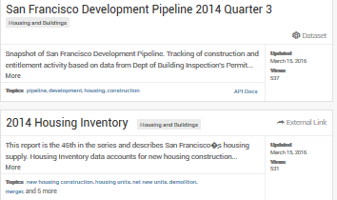
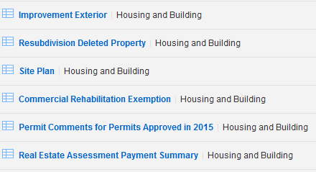
Accessibility
San Francisco Open Data Portal
Arlington County Open Data Portal
Link goes here
Link goes here
Notes:
Here, we have a sample of the san francisco search page vs the arlington county. Looking at the san francisco open data, it is clear in the title what the data set is of and when it is coming from. The blurb at the bottom is an addition but is nice to inform the user more details of the dataset. Looking at the arlington county, while there are simple titles, it is not clear exactly what the “site plan” is or the context of “improvement extererior” There is also minimal information regarding the dates of the data. It is unclear until you go into the data what you are actually going to be looking at. This makes the user’s experience much longer and far more tedious.

Slide 44
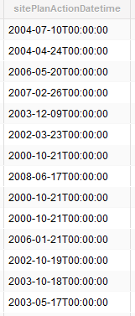
Accessibility
If data in your dataset is recorded over a multitude of years be sure to indicate this in the title
Historical data allows for the user to chart changes over time
Link goes here
Notes:
An important thing to note is that the dates are important to highlight and label properly because it changes how you can analyze the data. If the dataset includes data from multiple years, make sure to include the range of these years so that users can look at changes over time and create models. Otherwise it is hard one, to know what years you are looking at and two, how useful the dataset it at first glance.

Slide 45
Accessibility
Safety (What data can I get?)
Personally Identifiable Information (PIIs) are accounted for
When possible, Unique Identifiers are replaced with PIIs
Notes:
Safety is a big issue in the new age of open data. This gets at the quesiton of what data can I get? While having enough data up and free for the public, it is important to not always include everything. A big thing to be careful of is PIIs (personally identifiable information). These should be avoided for the safety of individuals and legal purposes. While it is decided what is okay on a case to case basis, staying on the safe side is never a bad idea.

Slide 46
Accessibility
Personally Identifiable Information (PIIs)
Any amount personal information which could link a data value to a particular individual
(eg. names, Social Security numbers, biometric records, etc)
Notes:
In more detail, a PII is any amount of personal information which could link a data value to a particular individual. Basically, if you can look at the dataset and find out exactly who is being recorded, you have a PII.

Slide 47
Accessibility
Sharing (Is this data usable?)
Website and dataset code is made publicly available
Public APIs are available and fit for use
Notes:
FInally, we have to ask, is this data usable? Website and dataset code should be available to help users understand where everything is coming from and to make their own changes to algorithms

Slide 48
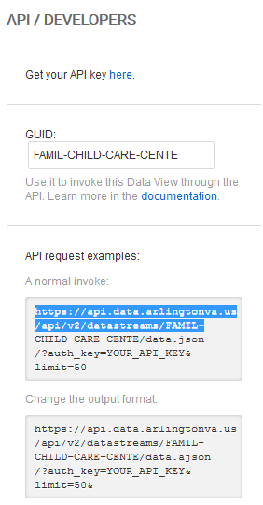
Accessibility
APIs are available
However, APIs are not useful unless data is TIDY!
Link goes here
Notes:
APIs are used by businesses and entrepreneurs to analyze the community to better meet the area's needs. And app developers can use APIs to create useful walkability apps or services apps. While you may have the API available, it is important to note, these APIs are useless unless the data has a basic tidy structure shown in the previous section.

Slide 49
Data Documentation
Jessica Flynn

Slide 50
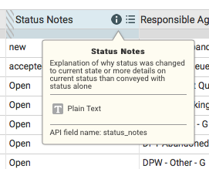
Documentation
Metadata
Coding is defined for each dataset
Ability to scroll over variables for a description
Define each level of categorical variables
Master data dictionary
Ability to search for a variable
Detect which datasets contain each variable
Cross-reference info
https://data.sfgov.org

Slide 51
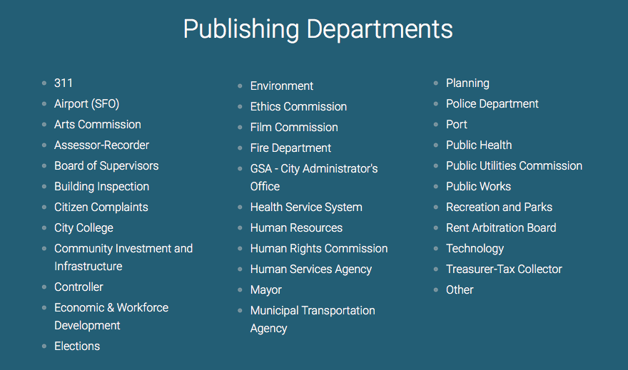
Documentation
Sources
Where is the Arlington County data coming from?
Government agencies
Departments
Commissions
Events
https://data.sfgov.org

Slide 52
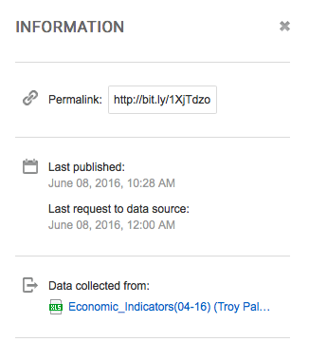
Documentation
Sources
Where is each data set coming from?
Clear indication of the origin of each data set
Explanatory file names
Explain how data was collected (if applicable)
Blurb describing context
Example below
Link goes here
https://data.cityofchicago.org

Slide 53

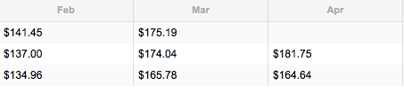
Documentation
Data
Raw, unaltered data should be available
Calculation performed on the datasets should be explained
Ex: averages, rates, summaries
Missing values from the original data should not be filled in
Person working with the data has the choice on what to do with it
Link goes here

Slide 54
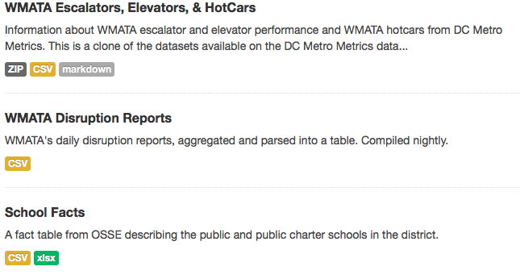
Documentation
File Type
Should be clear what file type is available to work with
.XLXS vs. .CSV file
http://opendatadc.org/dataset

Slide 55
Data Visualization
Samantha Tyner

Slide 56
Visualization
Need to consider:
Appearance
Access
Notes:
When providing users of the open data portal with pre-made data visualizations or the ability to create their own visualizations, there are two areas that need your careful consideration: appearance and access.

Slide 57
Visualization Appearance
All visualizations should:
Be clearly labeled
Remain true to data
Avoid unnecessary elements (“chartjunk”)
Bonus: Contribute to utility of data and tell a story.
Notes:
For the appearance aspect, you should be certain that all visualizations pre-made or created via the portal are clearly label throughout (axes, titles ,etc); remain true to the data and don’t mislead the viewer; avoid unecessary elements, also known as chartjunk, that crowd the view and obfuscate the information presented. A special bonus would be to ensure that all pre-made visualization contribute to the overall understanding and utility of the data source they show. A great visualization tells a story about the data.

Slide 58
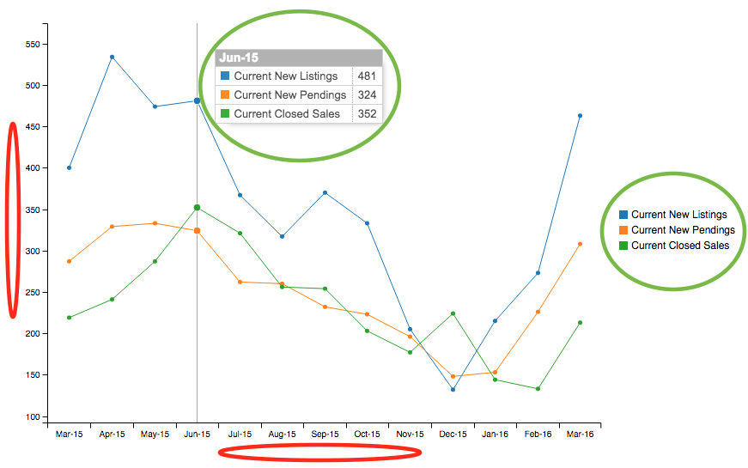
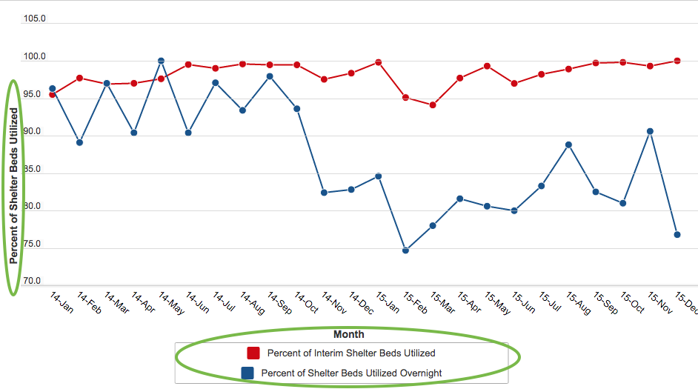
Clear labelling throughout
e.g. AC ODP - Housing Chart: Monthly new listings, pending and closed sales.
e.g. Chicago ODP - Homeless Shelter System Monthly Utilization
https://data.cityofchicago.org/Administration-Finance/Performance-Metrics-Family-Support-Services-Homele/eep4-c978
https://data.arlingtonva.us/visualizations/26314/housing-chart/
Notes:
Left example: pretty good, but the viewer has to expend extra mental energy to determine what the axes are showing.
Right example: Clearly labeled x and y axes and legend.

Slide 59
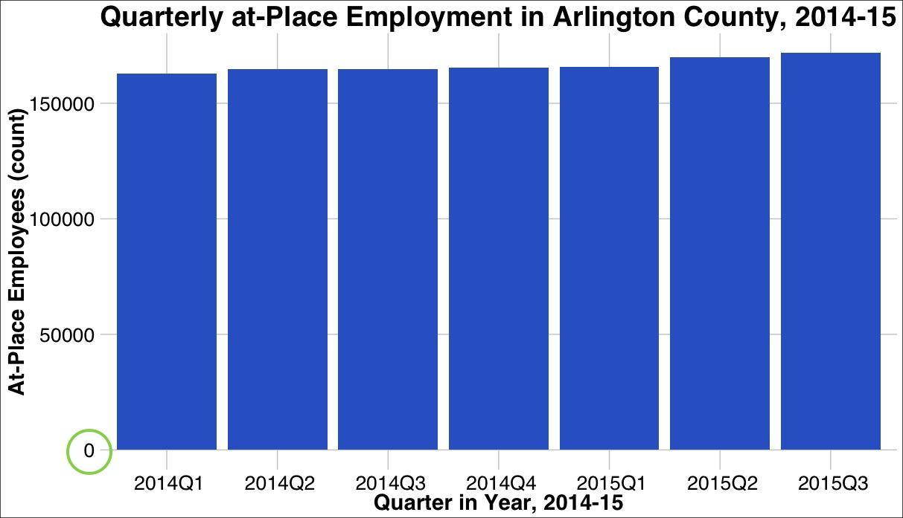
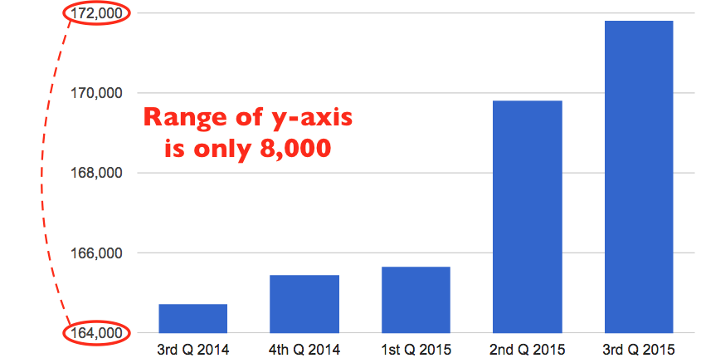
Remain true to data
e.g. AC ODP - At-Place Employment Employees Chart: Average quarterly at-place employment. Data excludes military personnel.
More accurate: y-axis begins at 0.
https://data.arlingtonva.us/visualizations/26305/at-place-employment-employees-chart/
Created by downloading the data from AC ODP and using plotting capabilities of RStudio.
Notes:
Left: Misleading. Range of y-axis is only about 5% of the max value, making it look like employment has quintupled in a year!
Right: y-axis starts at zero, presenting the data much more truthfully. Made by downloading data! Yay AC!

Slide 60
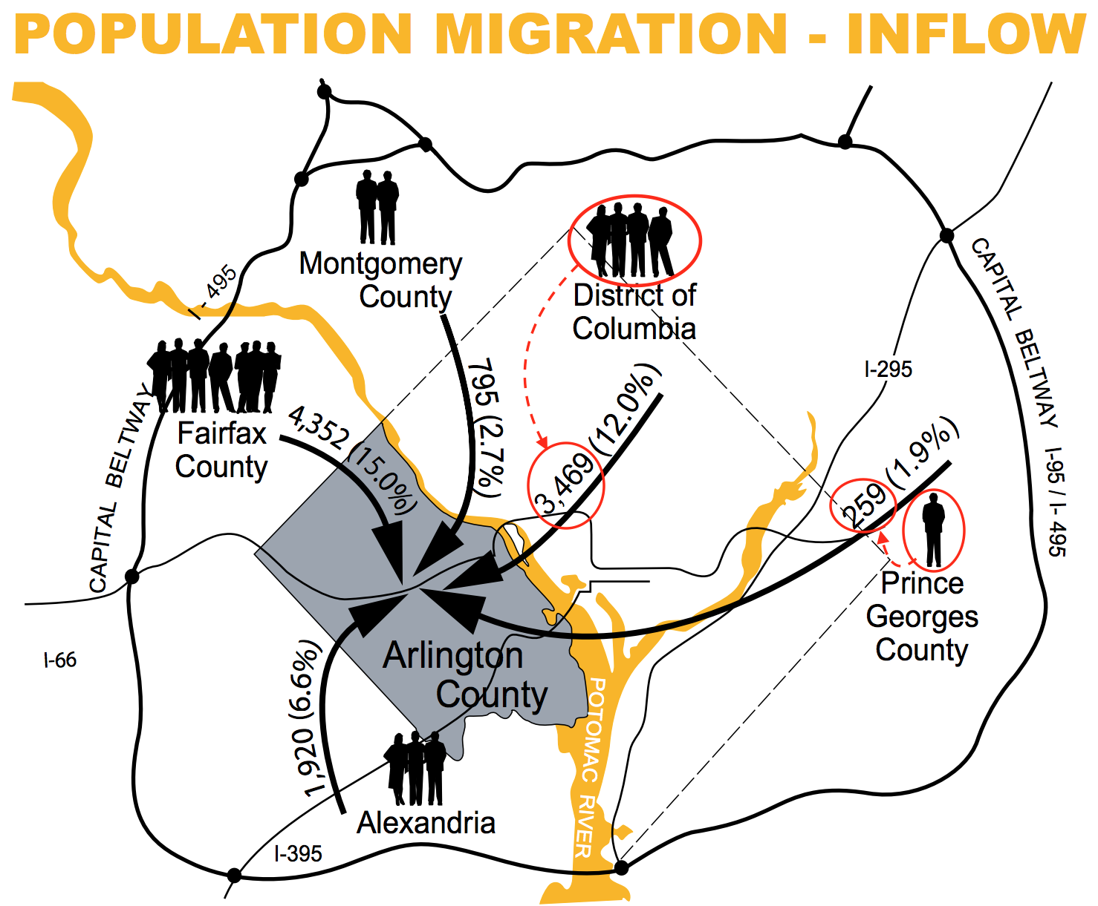
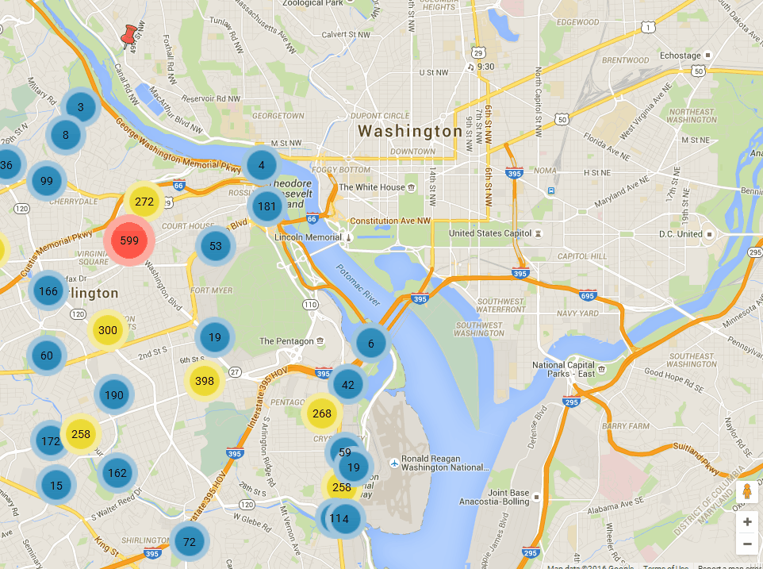
Avoid chartjunk
e.g. AC Profile 2016 - Population inflow into AC in 2012
e.g. AC OPD - Police Incident Log Map (Last 90 days): Map of reported criminal activity from the last 90 days.
https://arlingtonva.s3.amazonaws.com/wp-content/uploads/sites/31/2016/04/2016ProfilePagesFINAL.pdf
GIF Credit: Mark Almanza, created from
https://data.arlingtonva.us/visualizations/25934/police-incident-log-map-last-90-days/
Notes:
Left example: People are superfluous and misleading. 1 person corresponds to 259 people moving into AC, while 4 people correspond to 3,469 people moving into AC. But, the number of people from DC is actually 13 times as many as the number of people from PGC. Numbers are also printed: just use the numbers or update the visual to have 1 cartoon person represent, say 250 real people.
Right example: Overplotting and chark junk avoided by grouping incidents in the same areas until you zoom in to street level, revealing the individual incidents as pins.

Slide 61
Visualization Access
Tools for creating visualizations should:
Be quickly, easily accessible from data view
Be clearly labeled & easy to navigate
Bonus: Be reactive to data type
Notes:
The second aspect, visualization access, concerns the ability of the users of the ODP to create their own charts, maps, etc within the ODP. These tools should be quickly and easily accessible from the data view; the tools for creating visualizations should be clearly labeled and easy to navigate through. A special bonus would be to have the available visualizations be reactive to the data type. What I mean by that is that a scatterplot is an option for all numerical data, but not for all categorical data.

Slide 62
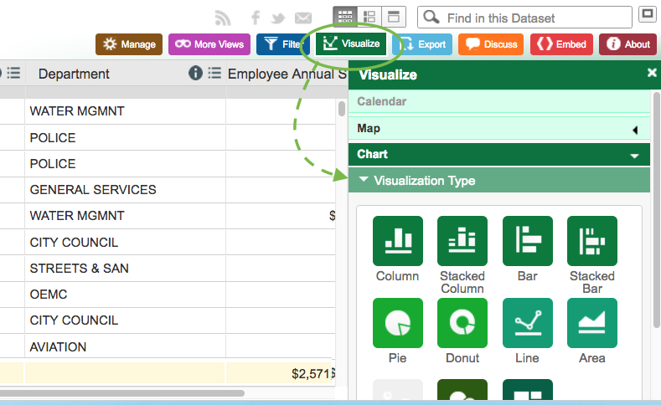
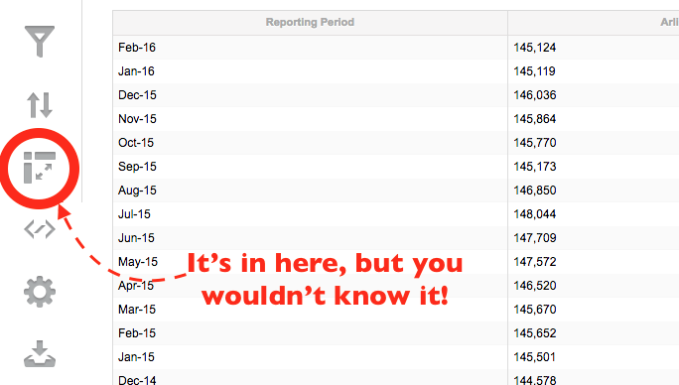
Access viz tools quickly & easily from data view
e.g. AC ODP - Civilian Labor Force: Monthly civilian labor force for AC and NoVa
e.g. Chicago ODP - Current Employee Names, Salaries, and Position Title
https://data.cityofchicago.org/Administration-Finance/Current-Employee-Names-Salaries-and-Position-Title/xzkq-xp2w
https://data.arlingtonva.us/dataviews/227239/civilian-labor-force/
Notes:
Left example: The tools for visualization are hidden in the pivot table tab. Without clicking around, it’s not discoverable.
Right example: The visualization tab is easily seen on top of the data table you’re looking at.

Slide 63
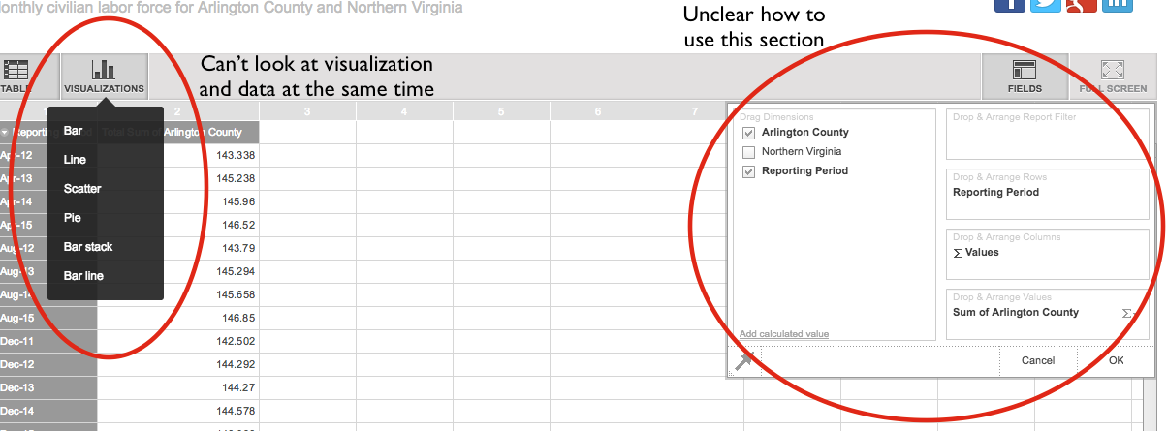
Viz tools are clearly labeled & easy to navigate
e.g. AC ODP - Civilian Labor Force: Monthly civilian labor force for AC and NoVa
https://data.arlingtonva.us/dataviews/227239/civilian-labor-force/
Notes:
This example: On the left, you cannot view the data and the visualization at the same time, which makes it difficult to know how to manipulate the visualization to create the best story. ON the right, the fields section is difficult to understand and use to create a visualization.

Slide 64
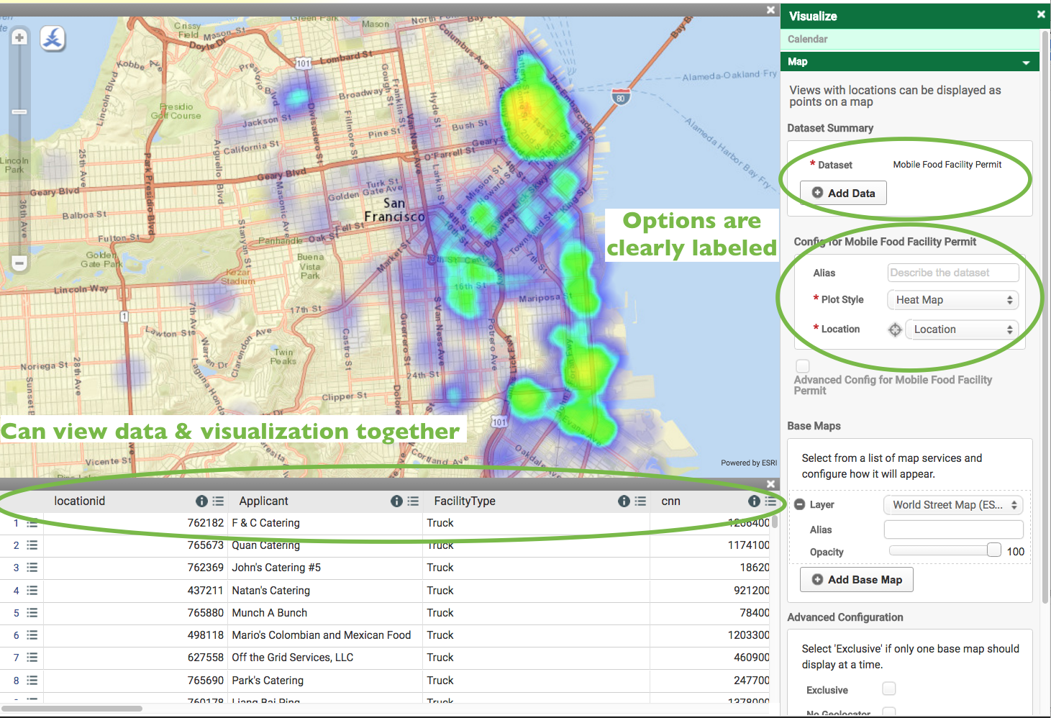
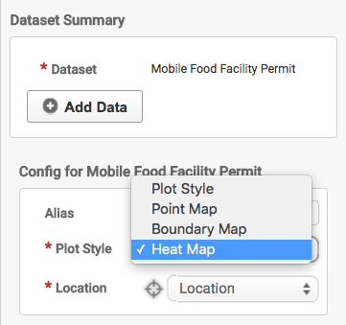
e.g. San Francisco ODP - Mobile Food Facility Permits
https://data.sfgov.org/Economy-and-Community/Mobile-Food-Facility-Permit/rqzj-sfat
Notes:
Top: The options available for visualization are neat, clear, and easy to select. Drop down menu.
Bottom: The data being visualized is seen with the visualization which helps refine the visualization creation process.

Slide 65
Thank you!

